Slide 2
The kingdom is the broadest category used in the system to classify living things.
Today, living things are classified into five kingdoms: monera, protoctista, fungi, plants and animals.

Slide 3
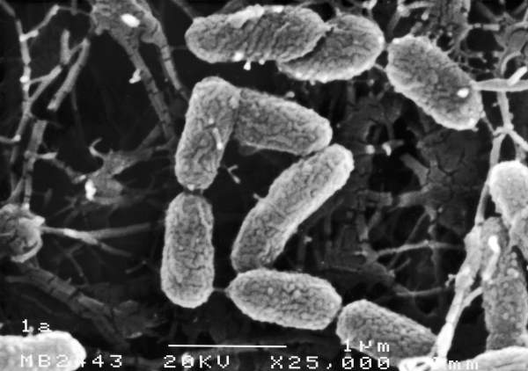
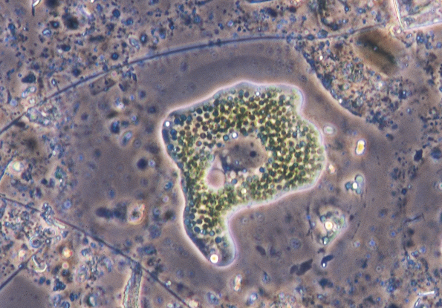
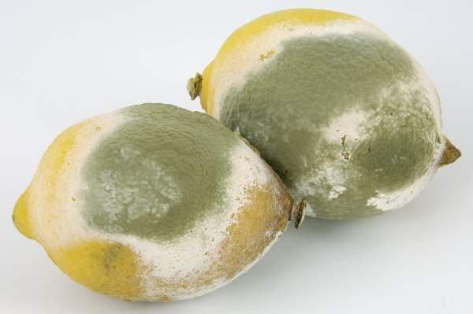
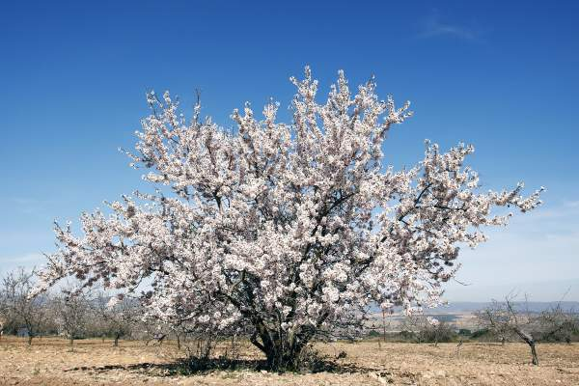
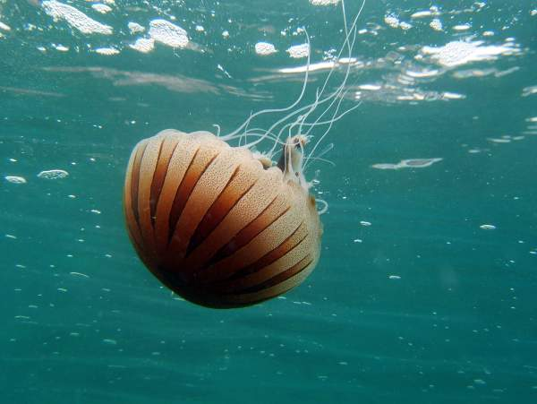
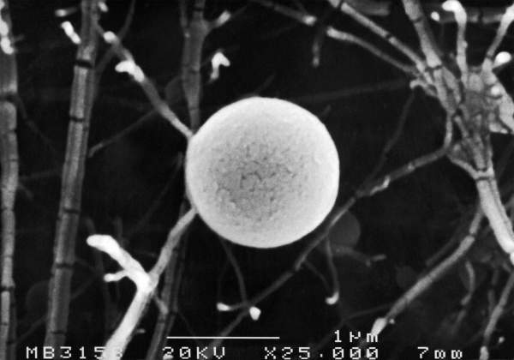
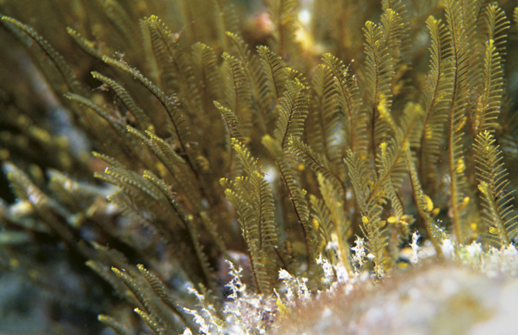
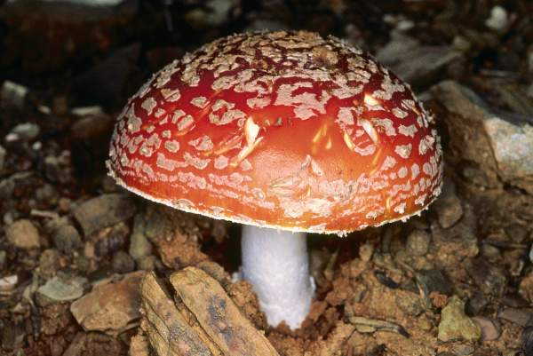
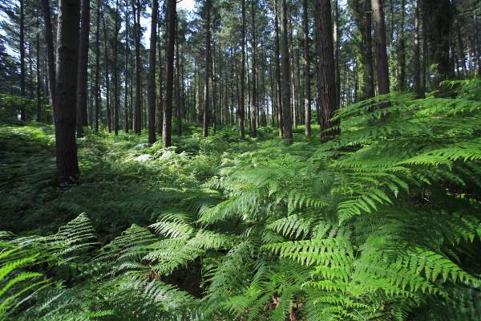
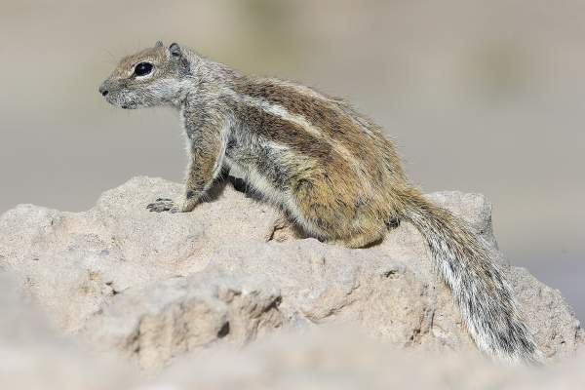
Living things
can be
Prokaryotes
Eukaryotes
MONERA
KINGDOM
PROTOCTISTA
KINGDOM
FUNGI
KINGDOM
PLANT
KINGDOM
ANIMAL
KINGDOM
Click on the green buttons to find out more about each kingdom

Slide 4
MONERA KINGDOM
• Composed of organisms with prokaryotic cells. (without a nucleus)
• They are all unicellular. They sometimes form colonies.
• Some examples:
Rod-shaped (bacillus) bacteria
Coccus-shaped bacteria
BACK

Slide 5
PROTOCTISTA KINGDOM
• Composed of organisms with eukaryotic cells. (with a nucleus)
• They can be unicellular, or multicellular with no tissues.
• Some examples:
Amoebae
Algae
BACK

Slide 6
FUNGI KINGDOM
• Composed of organisms with eukaryotic cells.
• They can be unicellular, or multicellular with no tissues.
• They are heterotrophic decomposers. (can’t make their own food)
• Some examples:
Moulds
Mushrooms
BACK

Slide 7
PLANT KINGDOM
• Composed of organisms with eukaryotic cells.
• They are multicellular organisms with tissues. Some have organs.
• They are autotrophic organisms. (can make their own food)
• Some examples:
Ferns
Almond tree
BACK

Slide 8
ANIMAL KINGDOM
• Composed of organisms with eukaryotic cells.
• They are multicellular organisms with tissues.
• Most of them have organs and some even have systems.
• They are heterotrophic organisms. (can’t make their own food)
• Some examples:
Jellyfish
Squirrel
BACK

